Slide 1
The Natural Science of Walter Russell

Slide 2
BIO
Matt Presti
www.MattPresti.com
Metascientist, Musician, Patriot, Philosopher, Poet, Practitioner of Universal Law, Natural Science and Living Philosophy, Audio and Video Producer, Broadcaster, and Host of The Exploration of Consciousness (TEC). Former Director of Operations and President of The University of Science and Philosophy (formerly the Walter Russell Foundation) January 1st, 2015-August 10th, 2021. Currently CEO of Universal Power, LLC. Volunteer firefighter on Montauk Rural Fire Department in Dent County, Missouri and Rockfish Valley Volunteer Fire Department in Nelson County, VA.
Notes:
History – 7 years – SOL - NDE

Slide 3
Productions
The Secret of Light Series
A 19 part video breakdown on the Natural Science and Philosophy of Dr. Walter and Lao Russell.
Frank Chester – The Wonder of Seven
A documentary on the Chestehedron, a seven sided form created by Frank, which is the geometry surrounding the heart.
Knowing The Creator
A four part series based on the teachings of Walrer and Lao Russell and other cosmic illuminates throughout time-immemorial and creation as a process.
Innerviews
A series of nine presentations featuring people who were interested in the Russells and various aspects of their work.
Dispelling Dimensional Madness
This documentary was created to take down the "belief" in higher dimensions, mythematics and new age scientism.
Free Will & Evil
Going into production later 2024.

Slide 4
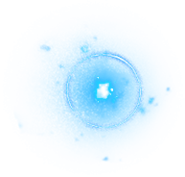
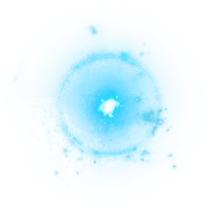
The home Study Course 3rd Edition Universal Law – Natural Science – Living Philosophy
Dr. Walter and Lao Russell
The University of Science and Philosophy
www.Philosophy.org

Slide 5
The Still White Magnetic Light – God, Creator, Mind
Notes:
We are but a mere chromosome different regarding our physicality

Slide 6
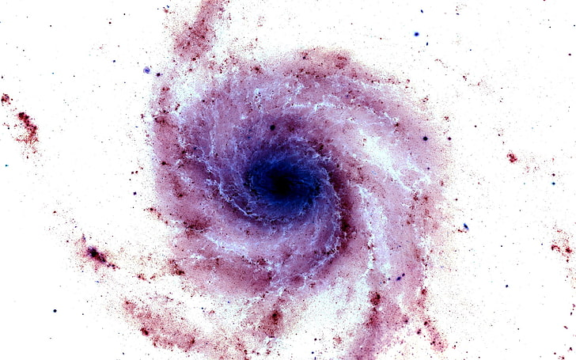
Notes:
We are but a mere chromosome different regarding our physicality

Slide 7
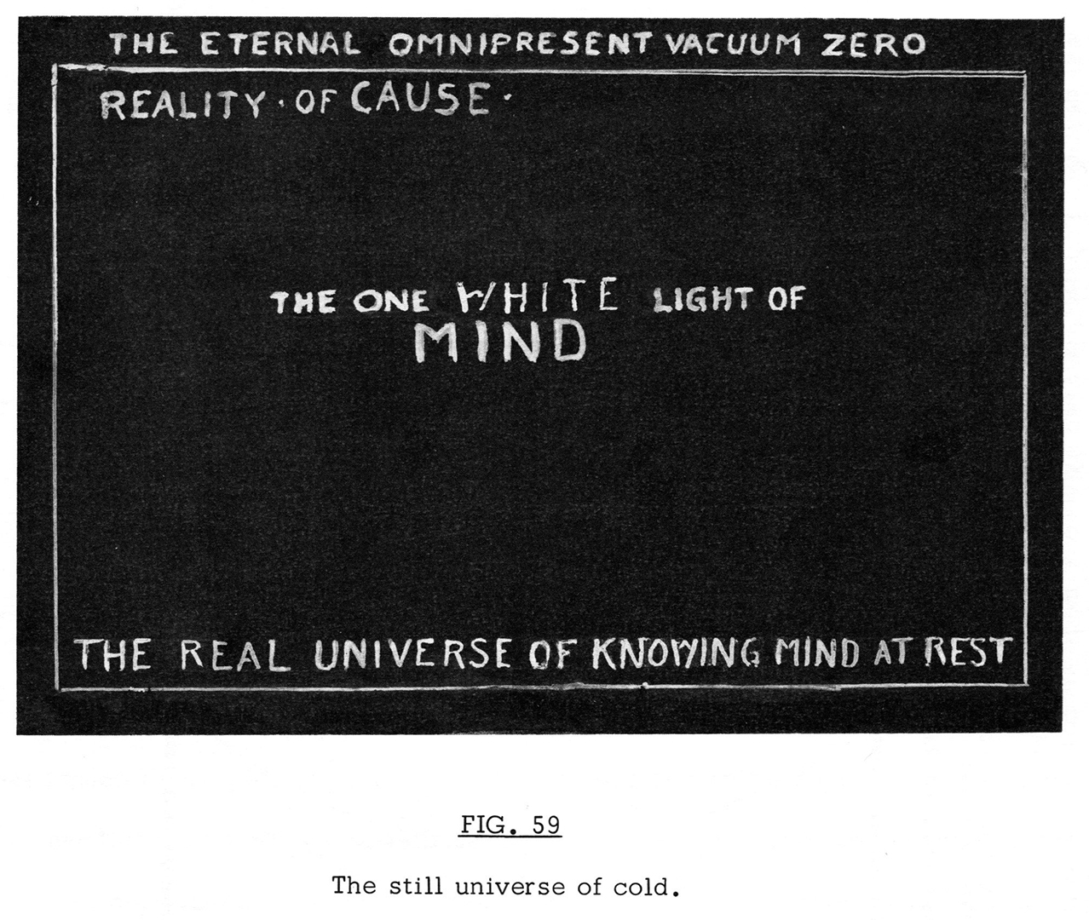
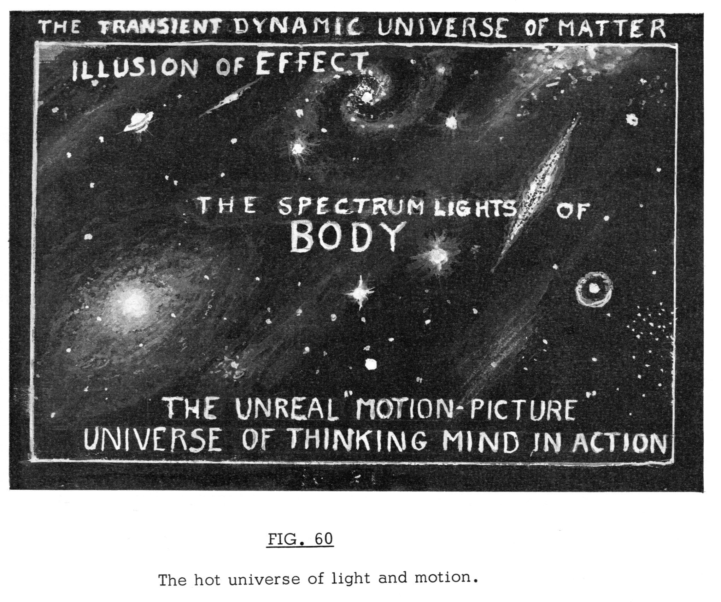
The Russell Cosmology

Slide 8
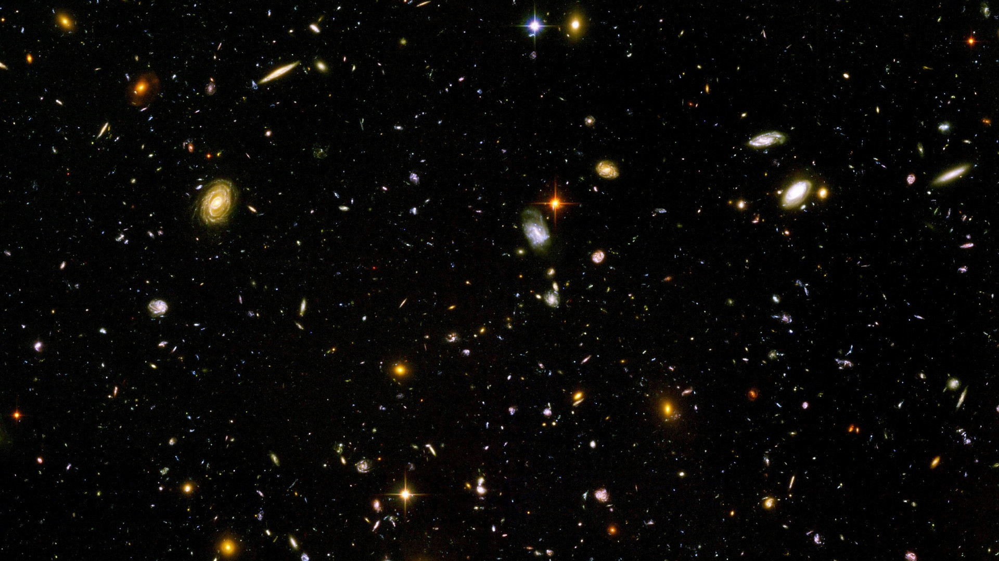
The Russell Cosmology
Mind
Matter

Slide 9
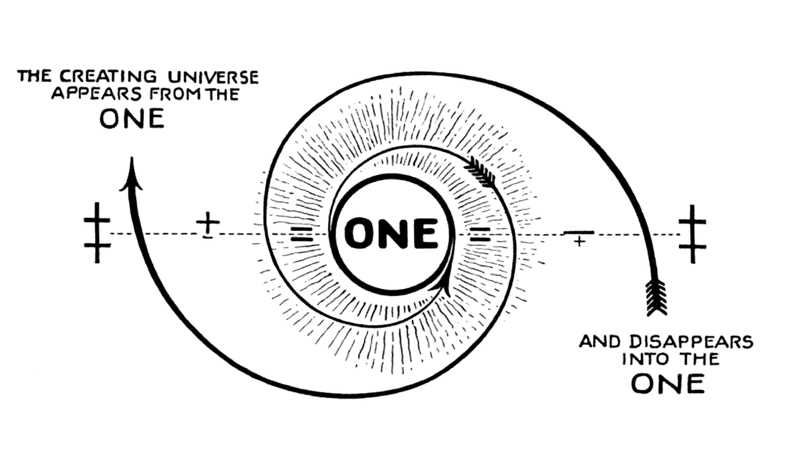

Slide 10
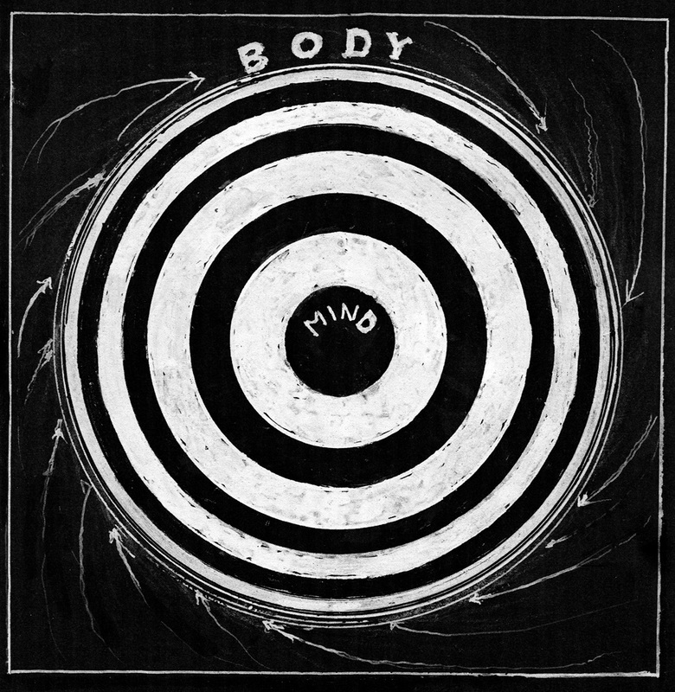
Notes:
What really is a leader?

Slide 11
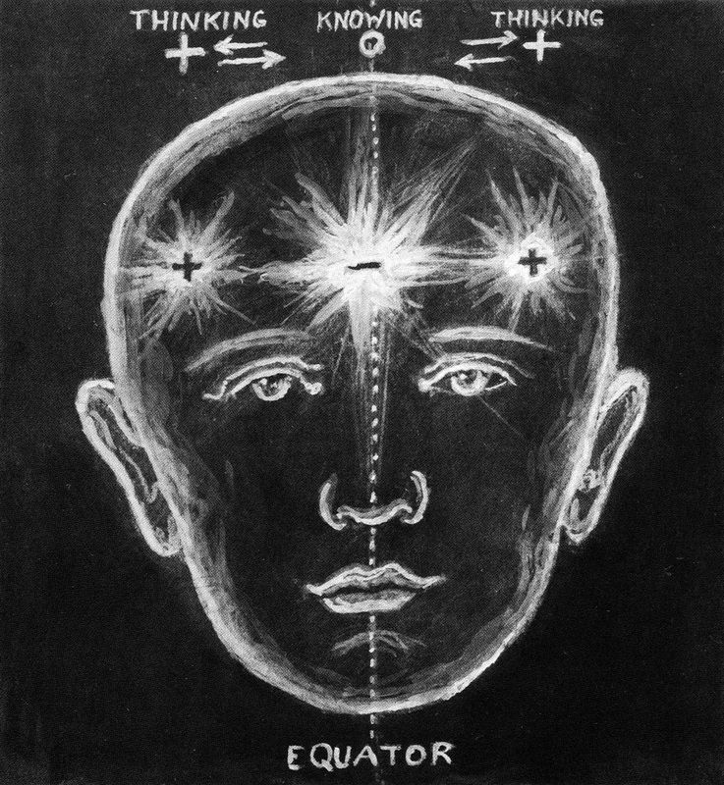
Notes:
What really is a leader?

Slide 12
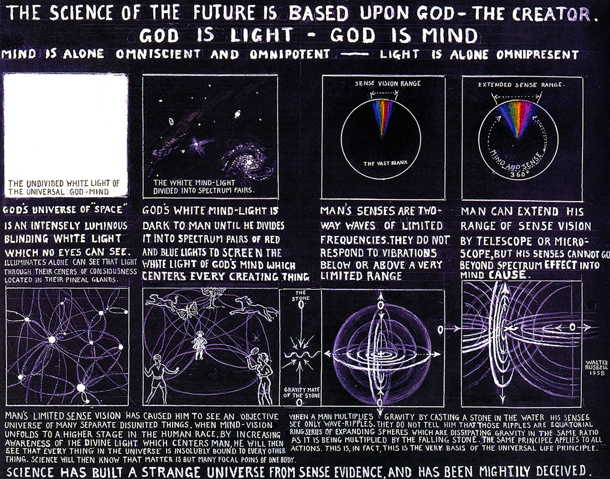
Notes:
What really is a leader?

Slide 13
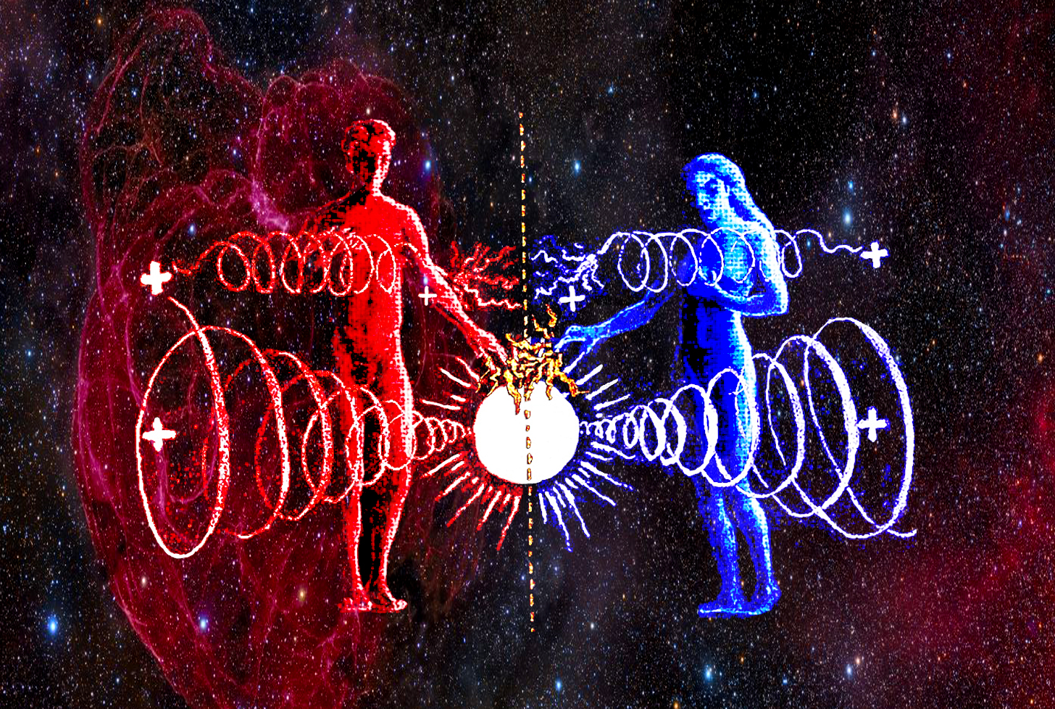
Notes:
We are but a mere chromosome different regarding our physicality

Slide 14
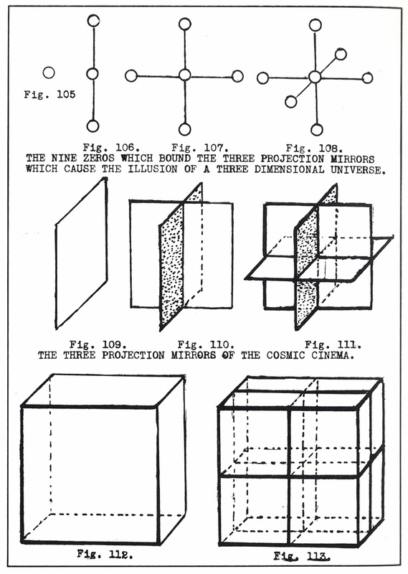
Notes:
What really is a leader?

Slide 15
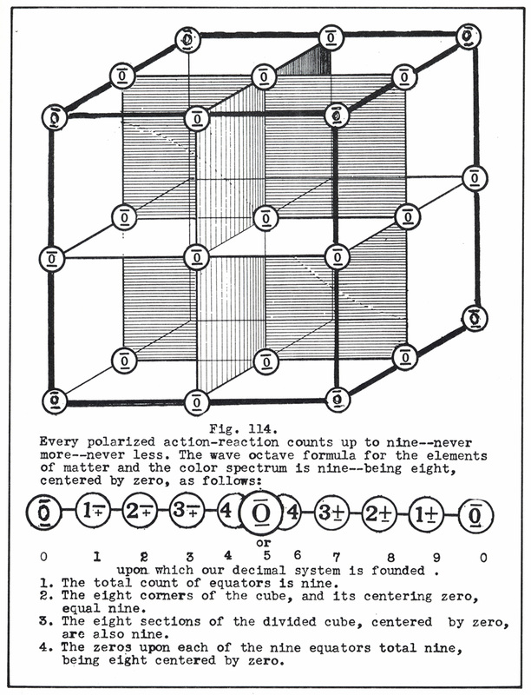
Notes:
What really is a leader?

Slide 16
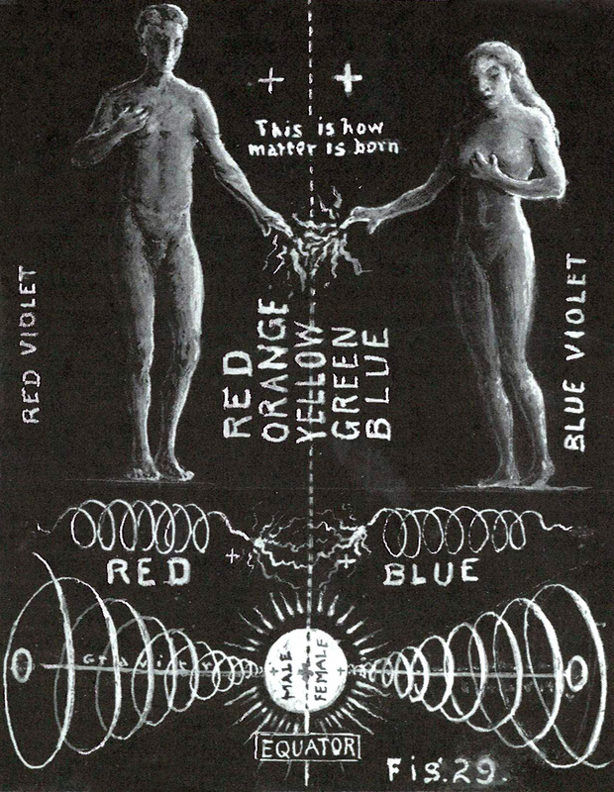

Slide 18
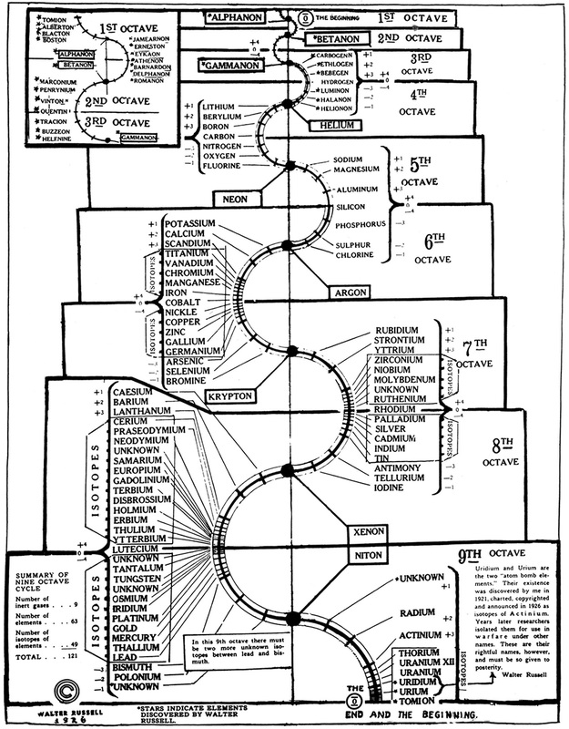

Slide 19
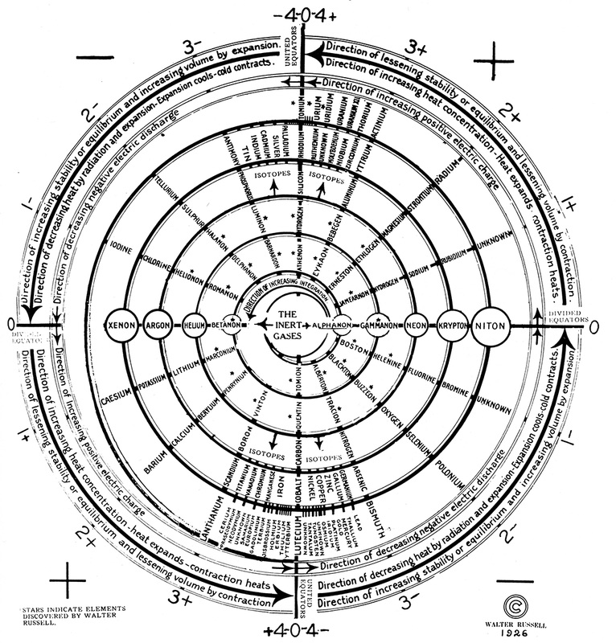

Slide 20
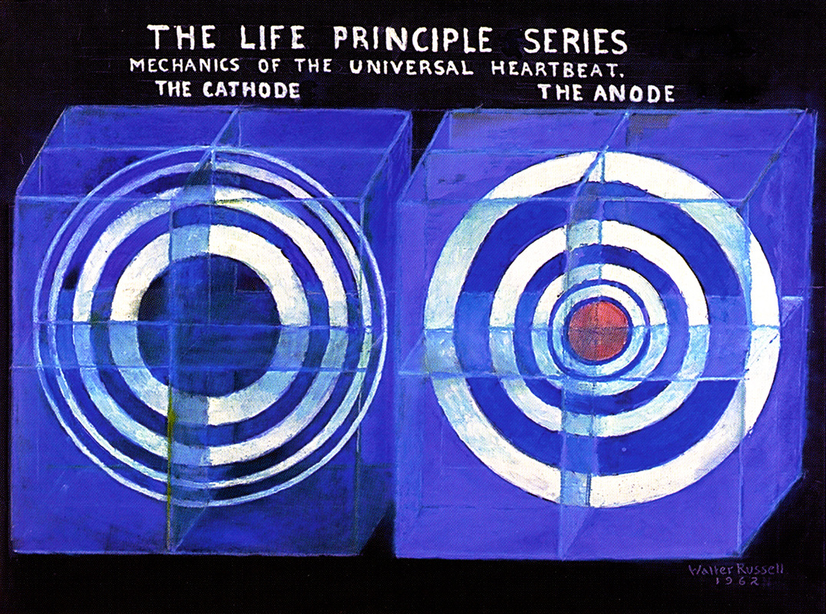

Slide 21
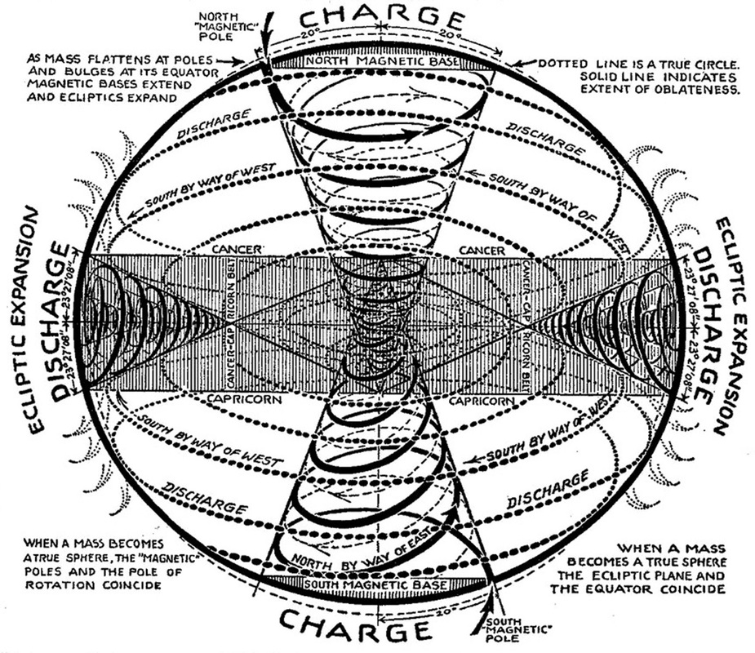

Slide 22
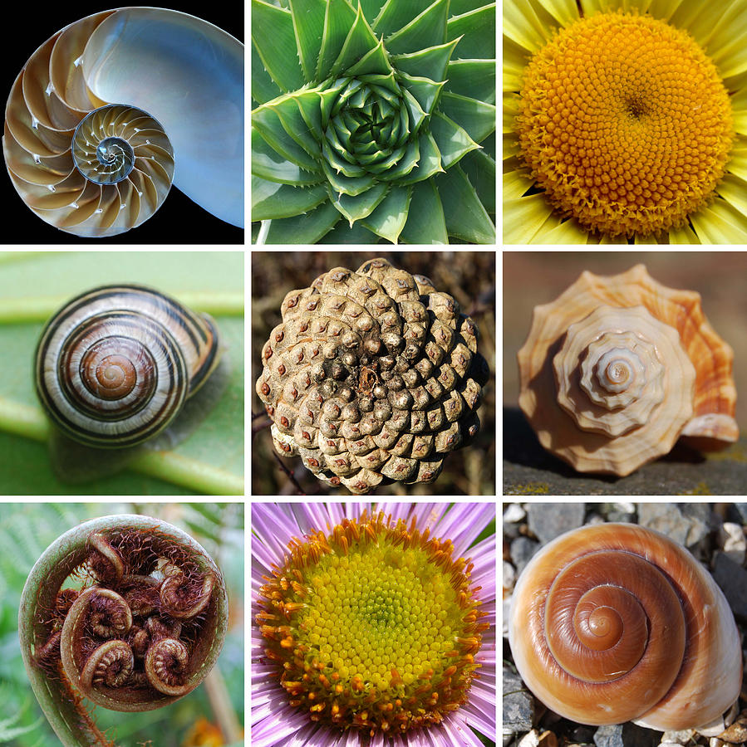

Slide 23
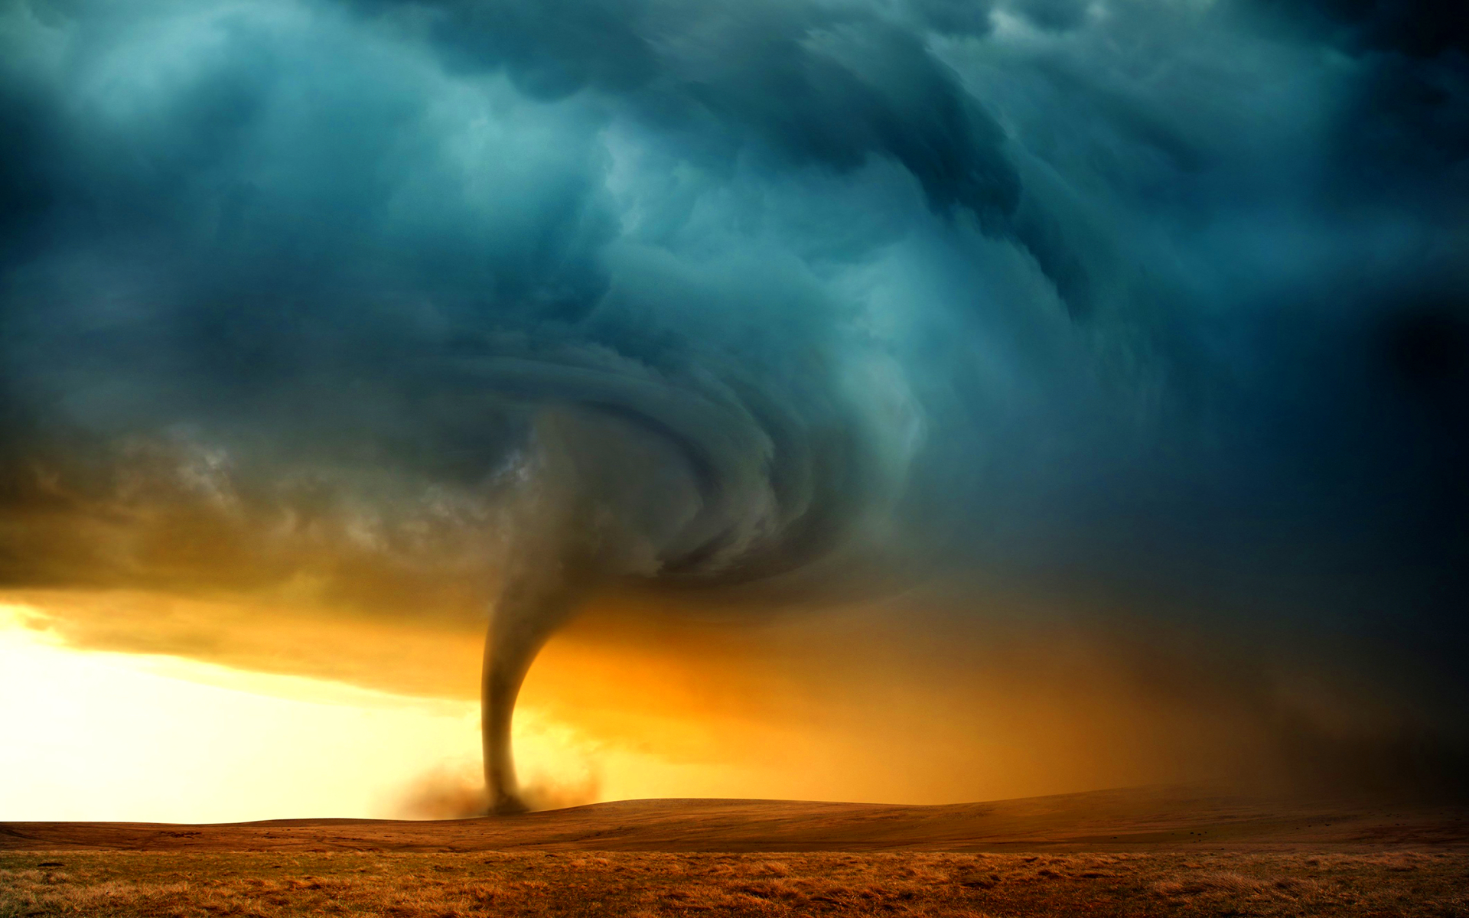

Slide 25
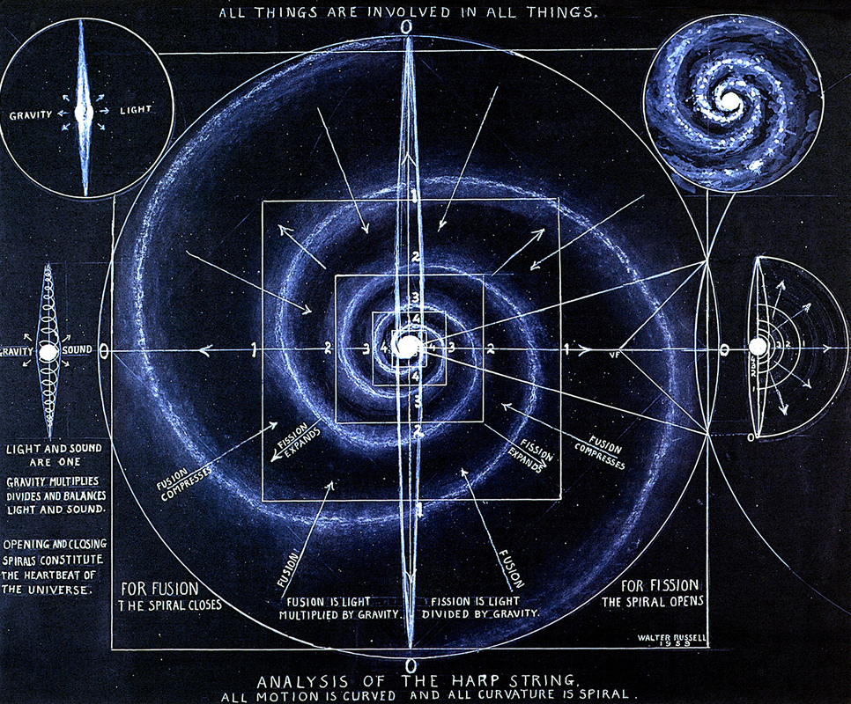

Slide 26
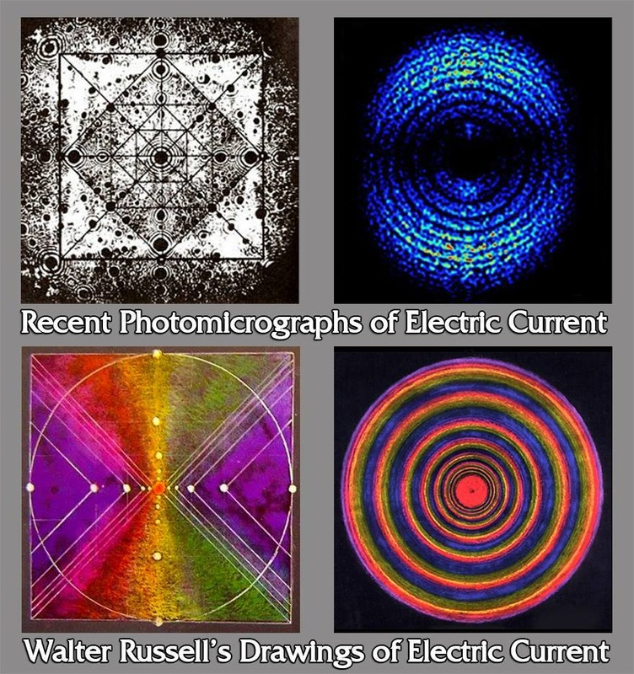

Slide 27
Notes:
Dr. Erwin Mueller’s Electron Microscopy

Slide 29
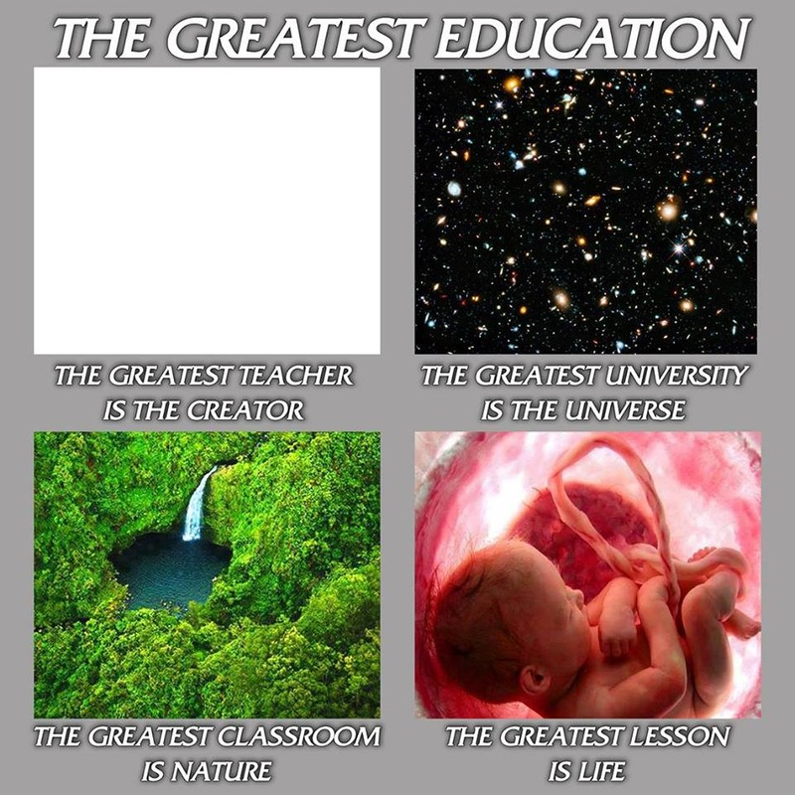

Slide 31
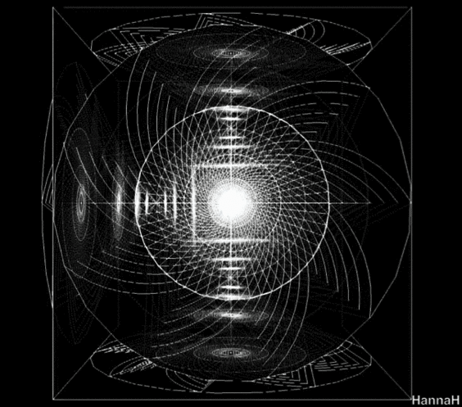

Slide 32
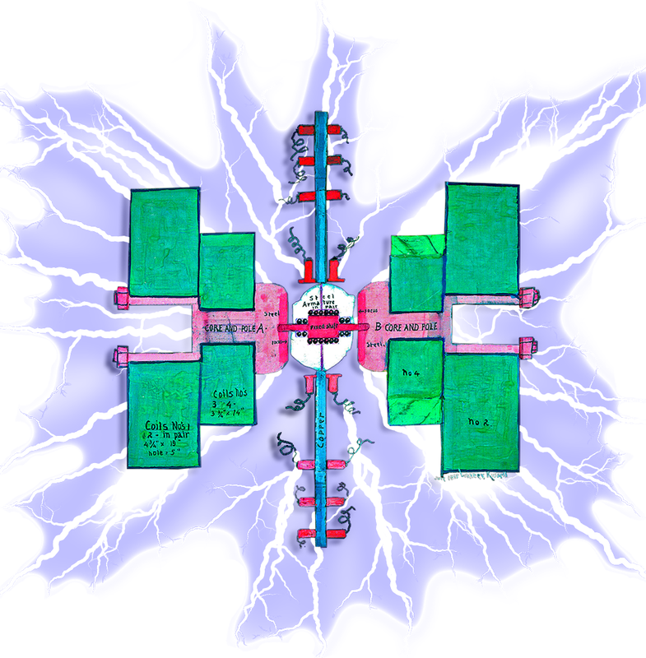

Slide 33
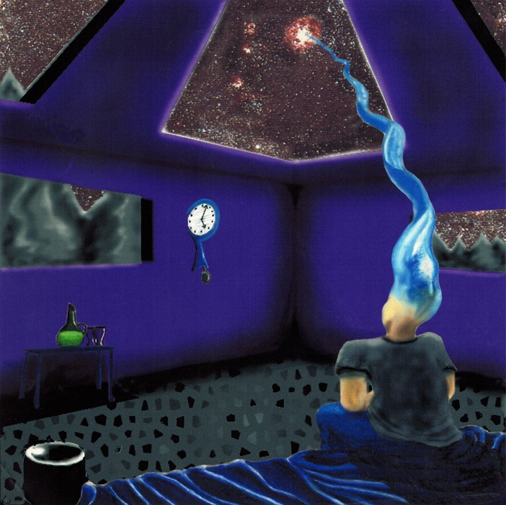
THANK YOU!!! QUESTIONS
www.Philosophy.org
ANARCHAPULCO20
www.MattPresti.com

